Slide 1
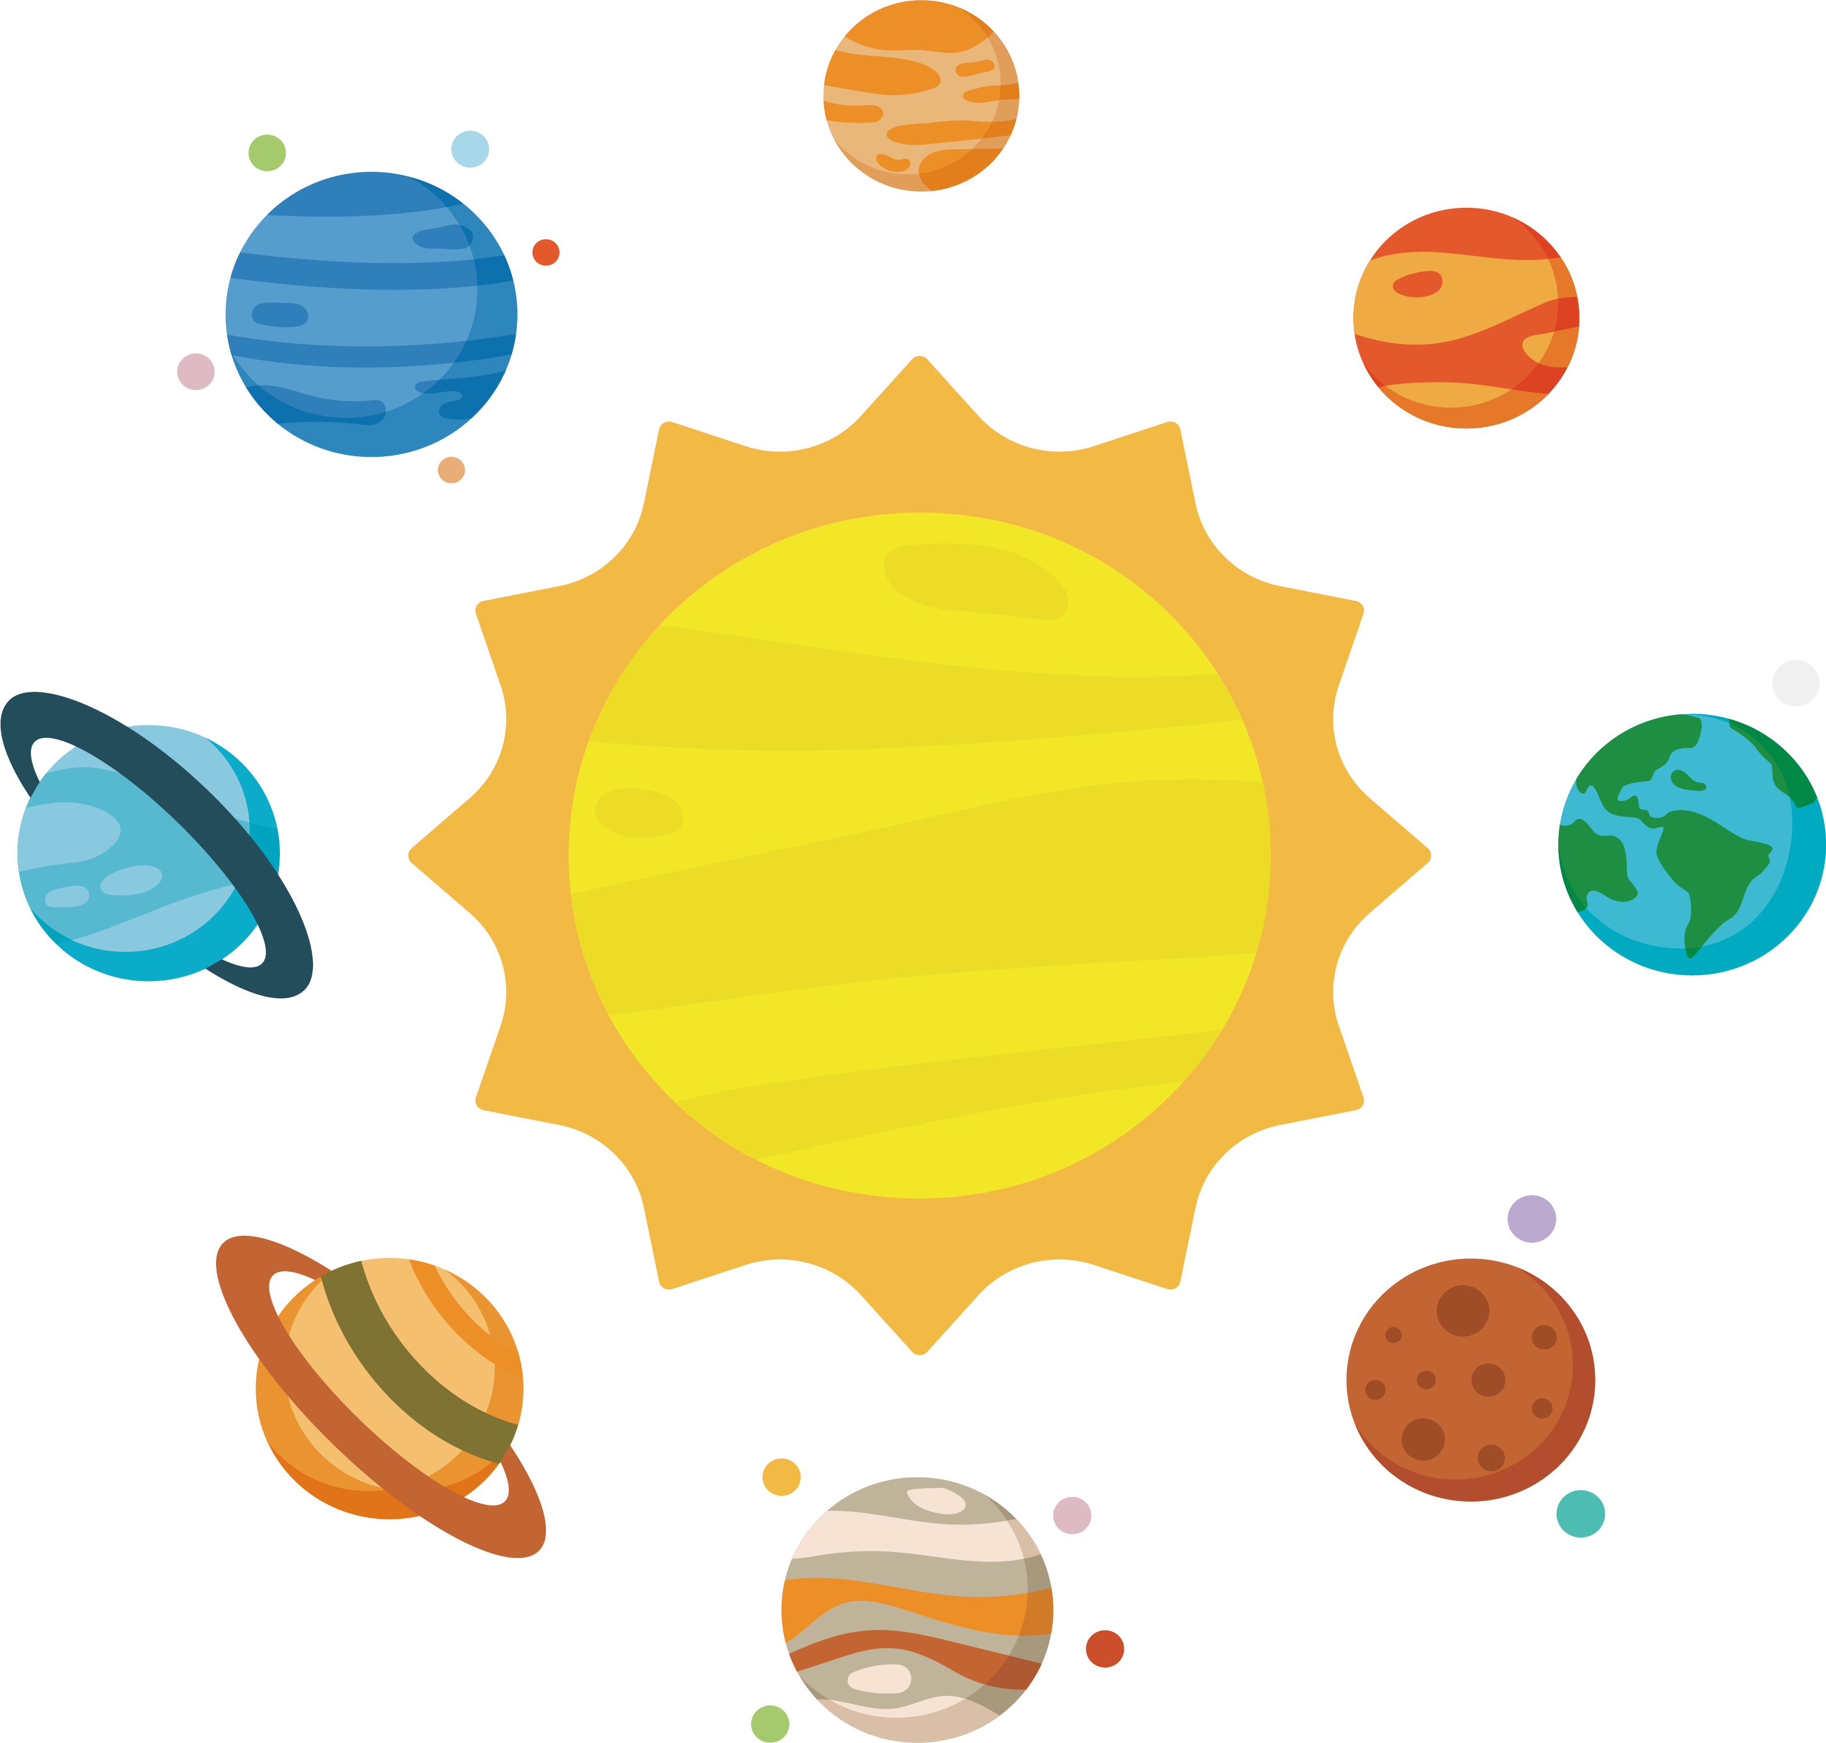
The solar system

Slide 2
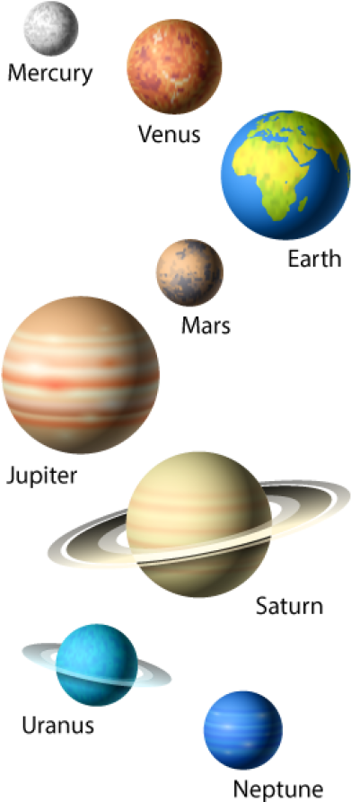
Planetary systems
A planetary system is a system of planets and other objects that orbit around a star.
Our planetary system is called «solar system» because we orbit a star called «sun».
In the solar system there are 8 planets, many satellites, asteroids, dwarf planets, comets etc.

Slide 3
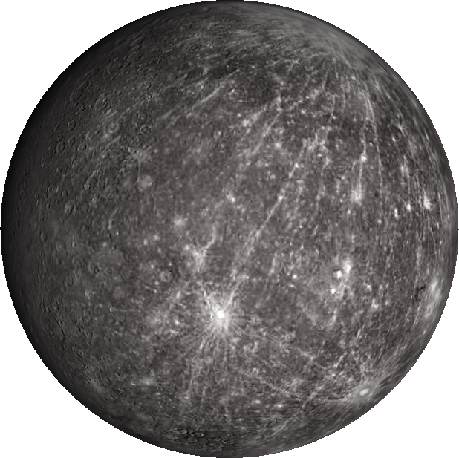
Mercury
Mercury is the smallest planet of our solar system, just a little bit bigger than Earth’s moon.
It’s a «rocky planet»: the surface is solid, covered with craters. It doesn’t have an atmosphere. Even though it’s the closest to the sun, it’s not the hottest planet.
A day on Mercury lasts 59 Earth days: it spins really slowly on itself.
A year on Mercury lasts 88 Earth days: it spins fast around the sun.
https://spaceplace.nasa.gov/all-about-mercury/en/

Slide 4

MERCURY’S IDENTITY CARD
NAME | Mercury
POSITION | 1
TEMPERATURE | 427 (max,.); -180 (min.); 167 (avg.)
MASS | 0,055 Earths
DIAMETER | 0,38 Earths
REVOLUTION TIME | 88 days
SATELLITES | 0
CURIOSITIES | Mercury is the closest planet to the sun, but it’s not the hottest.

Slide 5
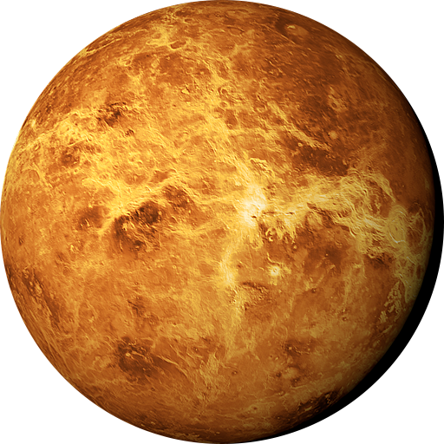
Venus
Venus is the hottest planet of our solar system.
It’s a «rocky planet»: the surface is solid, covered with volcanoes and mountains. It has got a thick atmosphere that traps heat and keeps it really hot.
It’s an unsual planet, because it spins the opposite direction of Earth and most other planets.
A day on Venus lasts 243 Earth days: it spins super slowly on itself.
A year on Mercury lasts 225 Earth days.
https://spaceplace.nasa.gov/all-about-venus/en/

Slide 6
VENUS’ IDENTITY CARD
NAME | Venus
POSITION | 2
TEMPERATURE | 464 (avg.)
MASS | 0,815 Earths
DIAMETER | 0.95 Earths
REVOLUTION TIME | 225 days
SATELLITES | 0
CURIOSITIES | Mercury is the hottest planet in the solar system

Slide 7
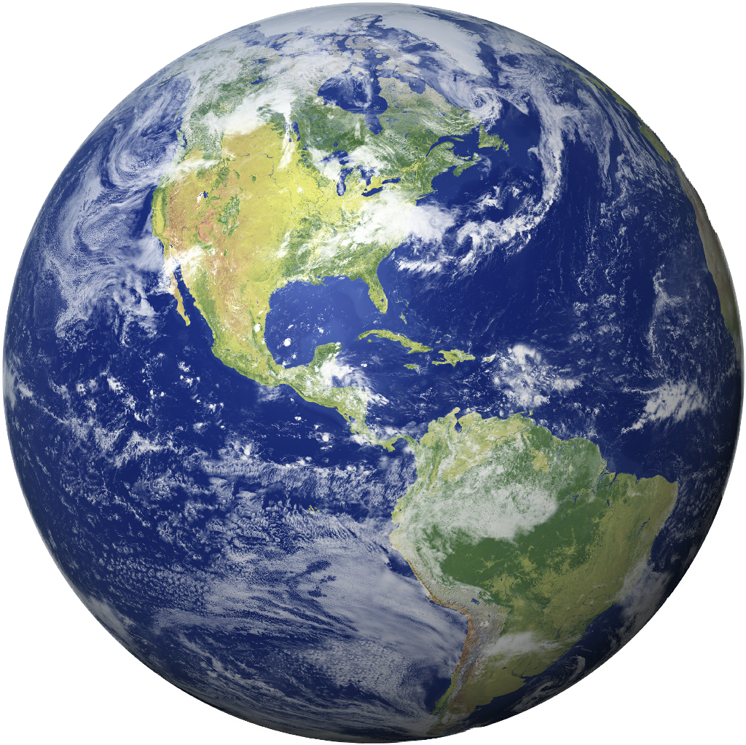
EARTH
Earth is the third planet of our solar system.
It’s a «rocky planet»: the surface is solid, and the 70% is covered with water. It has a got an atmosphere (with mostly nitrogen and oxygen) that protects us from meteoroids.
A day on Earth lasts 24 hours.
A year on Earth lasts 365.25 days.
https://spaceplace.nasa.gov/all-about-earth/en/

Slide 8
EARTH’S IDENTITY CARD
NAME | Earth
POSITION | 3
TEMPERATURE | -89 (min.); 14 (avg.); 57 (max.)
MASS | 1 Earth (5.9*10^24kg)
DIAMETER | 1 Earth (12756km)
REVOLUTION TIME | 365,25 days
SATELLITES | 1
CURIOSITIES | Earth is the only planet with liquid water on its surface.

Slide 9
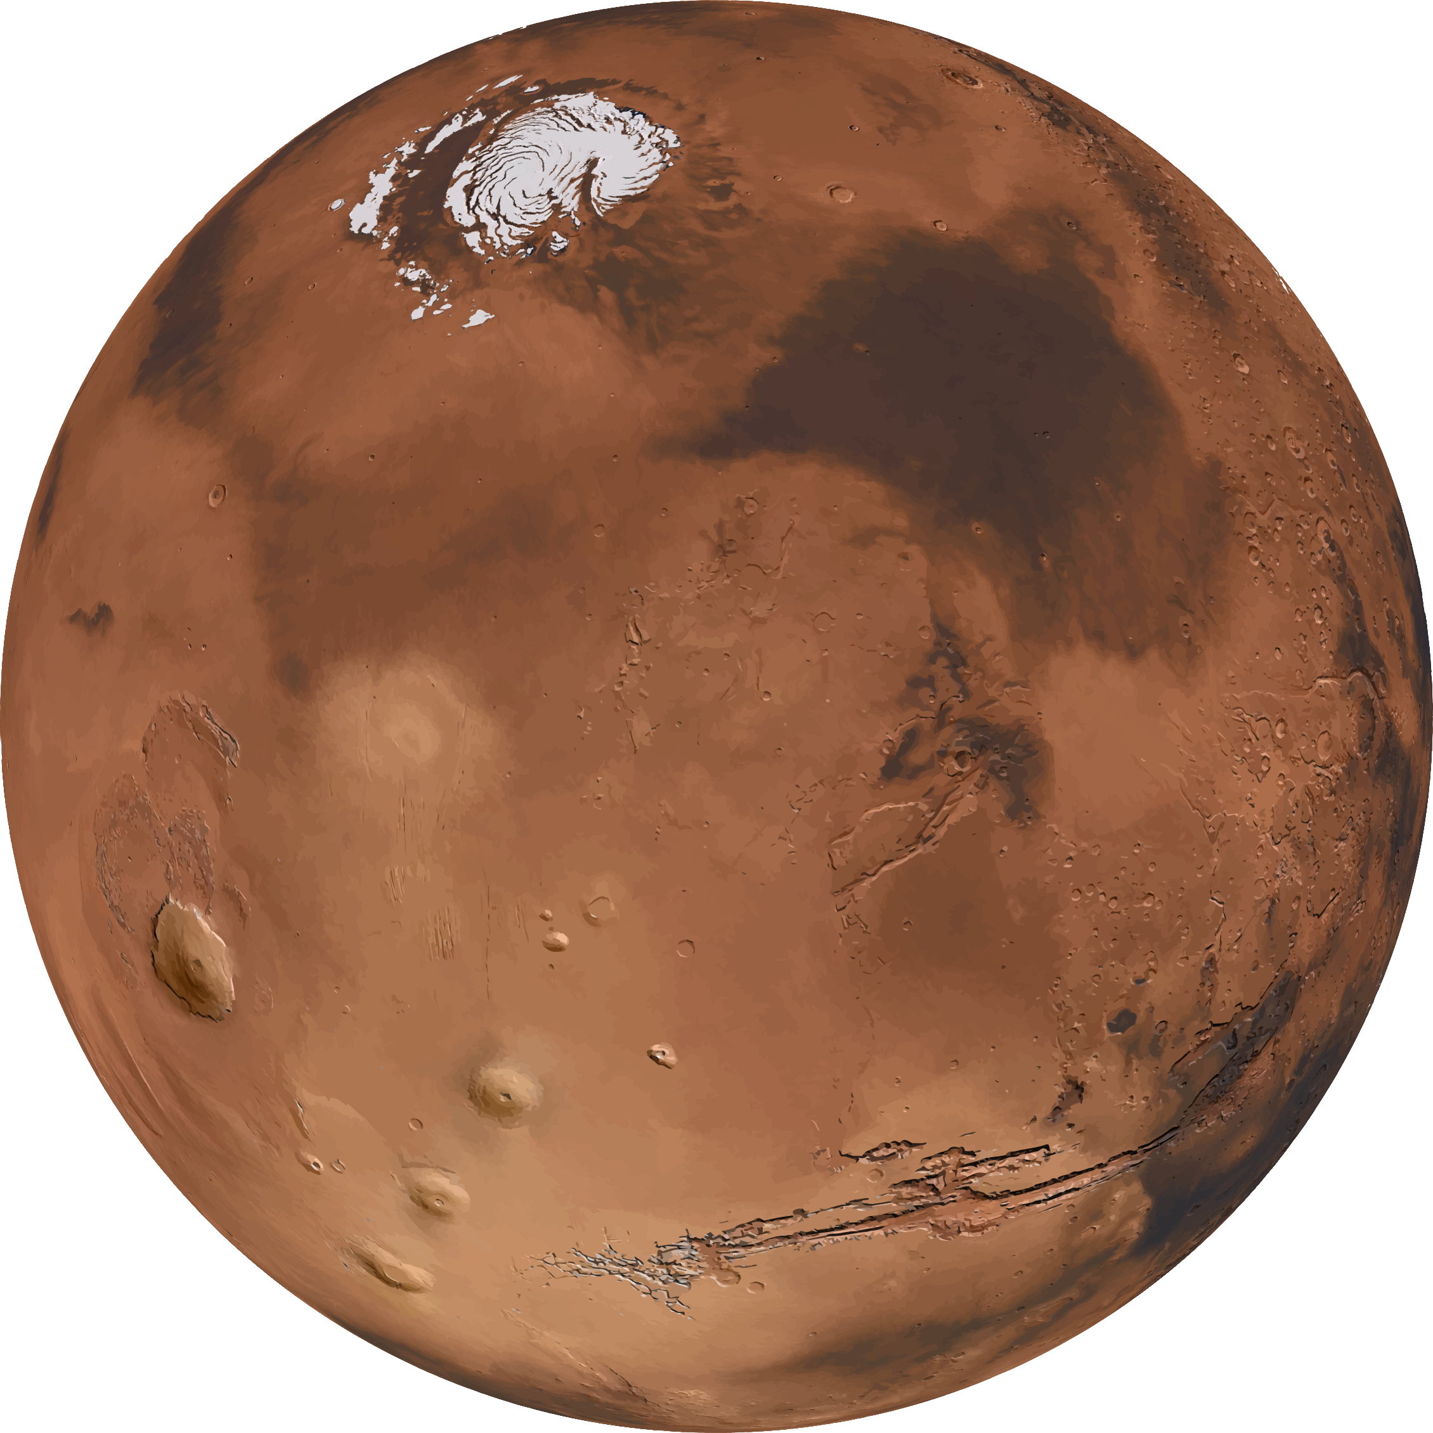
MARS
Mars is a cold, desert planet. It is also called «the red planet», because of rusty iron in the ground.
It’s a «rocky planet»: the surface is solid, with polar ice caps, volcanoes and canyons. It has a got a very thin atmosphere (with mostly carbon dioxide, nitrogen and argon).
There are signs of ancient oceans on Mars, but now water exists only in ice and thin clouds. Mars probably supported life in the past.
A day on Mars (SOL) lasts 24.6 hours: almost like on Earth.
A year on Mars lasts 687 days.
https://spaceplace.nasa.gov/all-about-mars/en/

Slide 10
MARS’ IDENTITY CARD
NAME | Mars
POSITION | 4
TEMPERATURE | -110 (min); -65 (avg.); 35 (max)
MASS | 0,11 Earths
DIAMETER | 0.53 Earths
REVOLUTION TIME | 687 days
SATELLITES | 2
CURIOSITIES | Mercury had liquid water on its surface in the past.

Slide 11
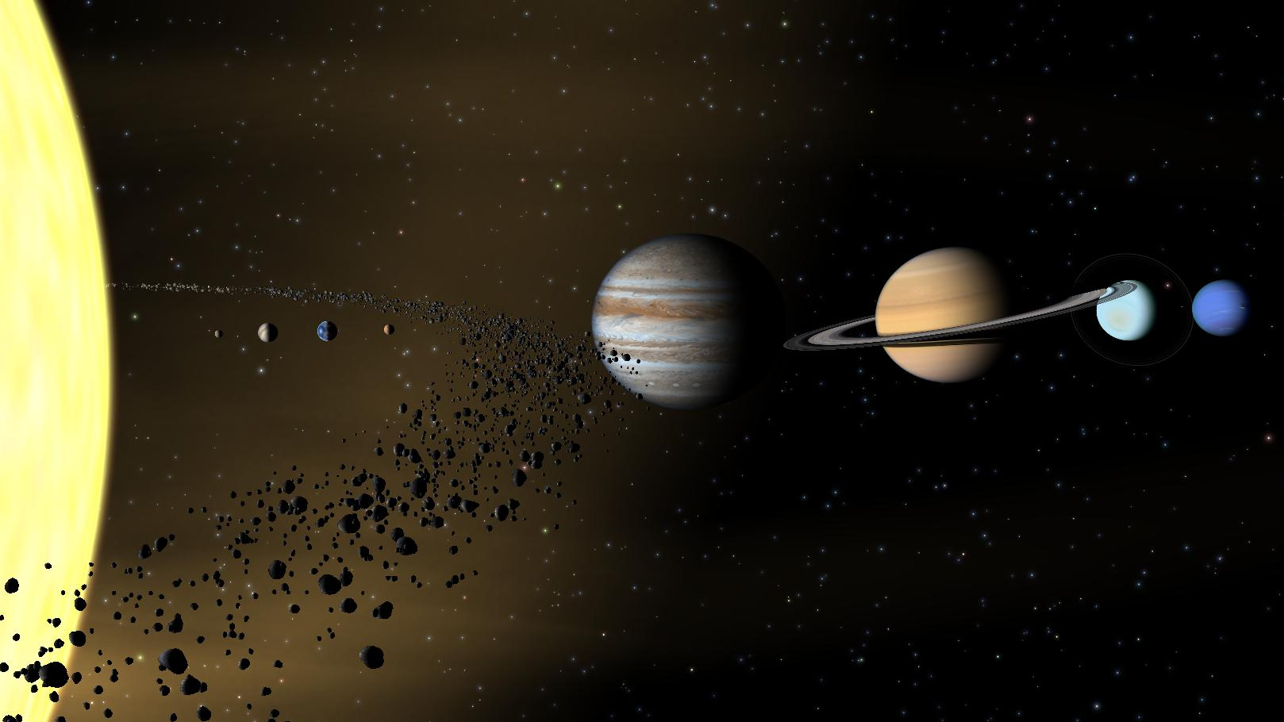

Slide 12
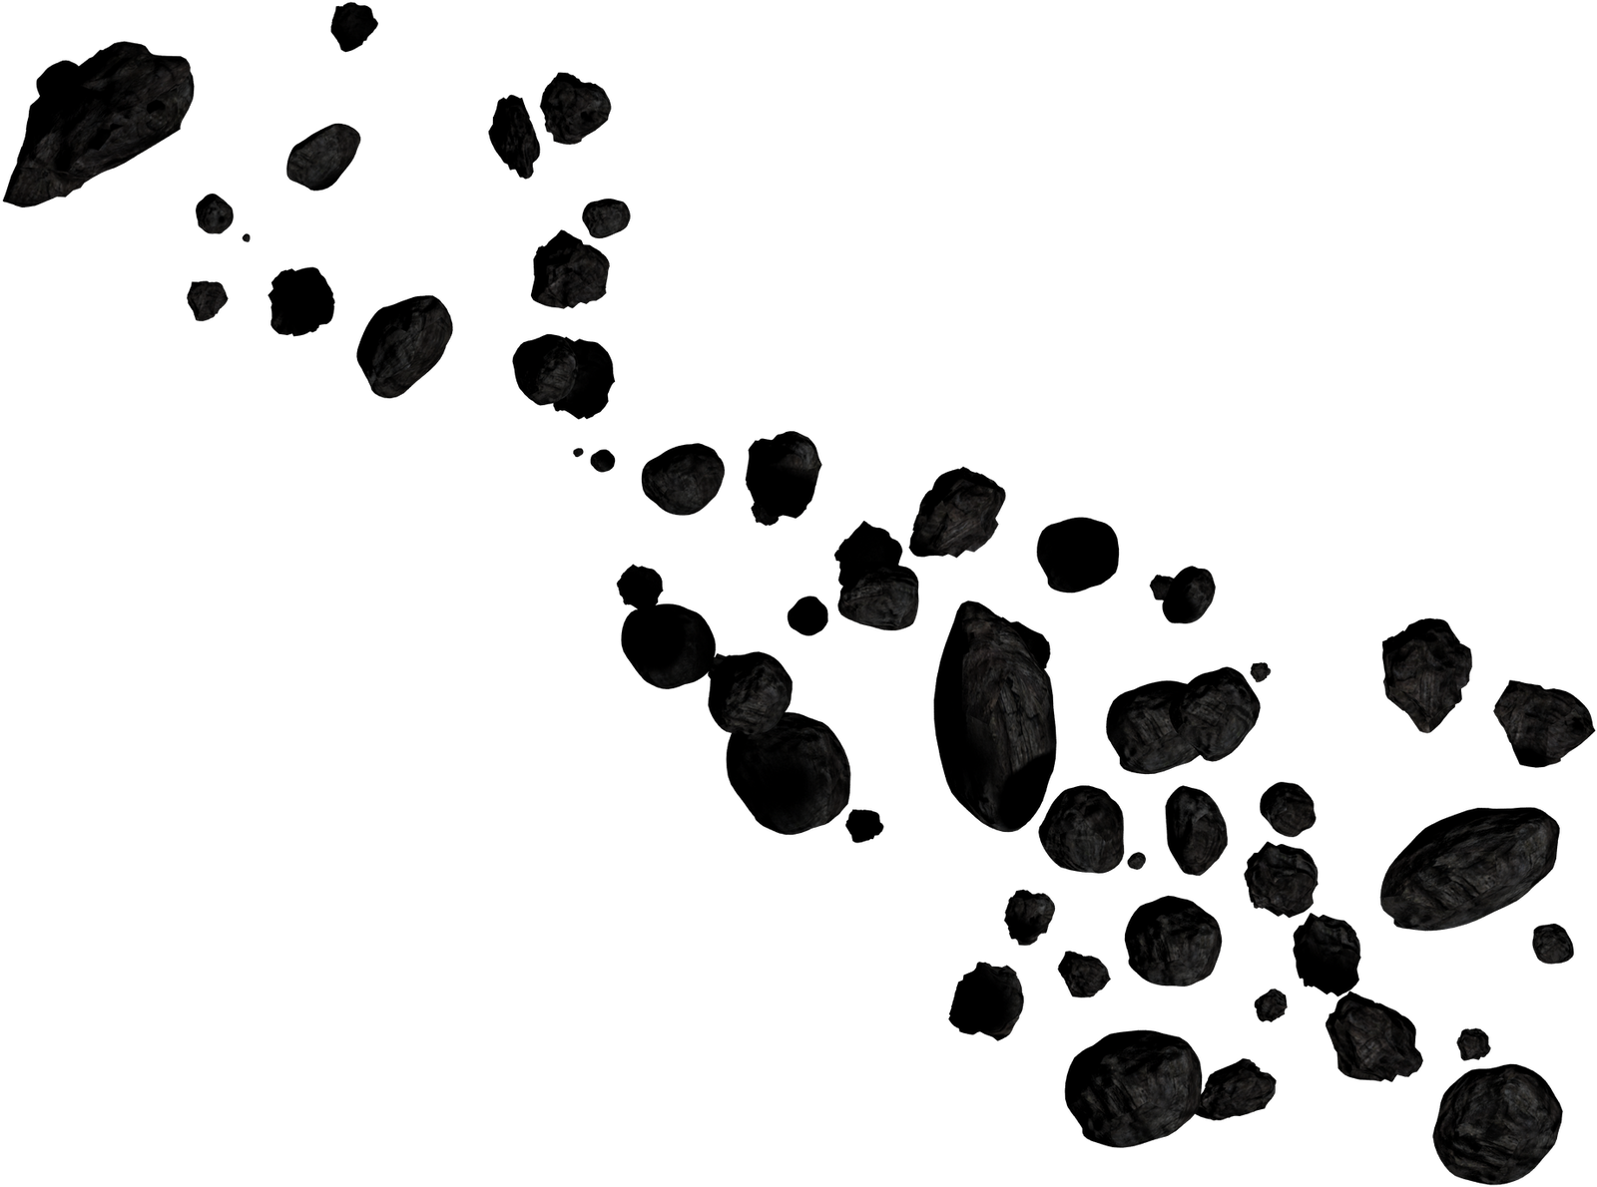
The main asteroid belt
Between the orbits of Mars and Jupiter we find the main asteroid belt.
The asteroid belt contains many irregularly shaped bodies, smaller than planets, called asteroids or dwarf planets.
Ceres is a dwarf planet of the belt.
Vesta, Pallas and Hygiea are the biggest asteroids of the belt.

Slide 13
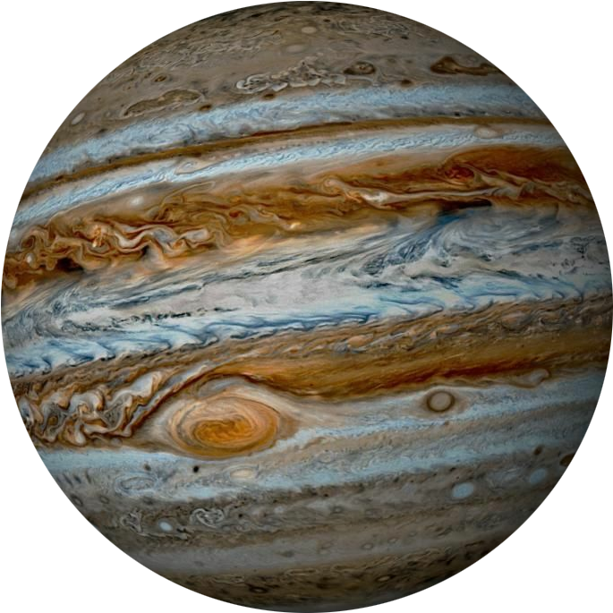
JUPITER
Jupiter is the biggest planet of our solar system. It’s similar to a star, but it’s not big enough to burn.
It’s a «gas giant»: it doesn’t have a solid surface. It’s made mostly of hydrogen and helium. It has got rings, but they are really hard to see. Jupiter has 80 confirmed moons.
A day on Jupiter lasts 10 hours. It spins really fast!
A year on Jupiter lasts 4310 Earth days (11,8 years).
https://spaceplace.nasa.gov/all-about-jupiter/en/

Slide 14
JUPITER’S IDENTITY CARD
NAME | Jupiter
POSITION | 5
TEMPERATURE | -110 (avg.)
MASS | 318 Earths
DIAMETER | 11,2 Earths
REVOLUTION TIME | 11,8 years
SATELLITES | 80
CURIOSITIES | Jupiter weighs more than all of the other planets combined. It’s called «Jupiter» because he is the king of planets.

Slide 15
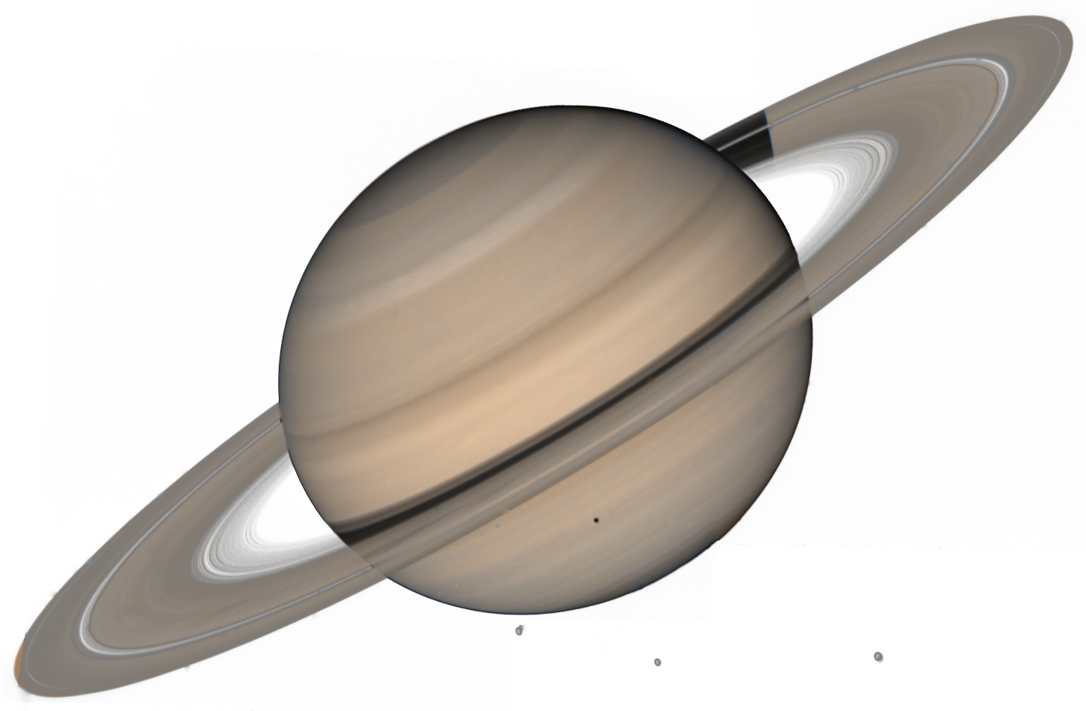
SATURN
Saturn is the planet with the most beautiful rings. The rings are made of rock and ice
It’s a «gas giant»: it doesn’t have a solid surface. It’s made mostly of hydrogen and helium. It has got 63 confirmed moons. It has got a set of 7 main rings, with spaces between them.
A day on Saturn lasts 10.7 hours. It spins really fast!
A year on Saturn lasts 10592 Earth days (29 years).
https://spaceplace.nasa.gov/all-about-saturn/en/

Slide 16
SATURN’S IDENTITY CARD
NAME | Saturn
POSITION | 6
TEMPERATURE | -140 (avg.)
MASS | 95,2 Earths
DIAMETER | 9,45 Earths
REVOLUTION TIME | 29 years
SATELLITES | 63
CURIOSITIES | Saturn isn’t the only planet with rings. It has got probably the most beautiful

Slide 17
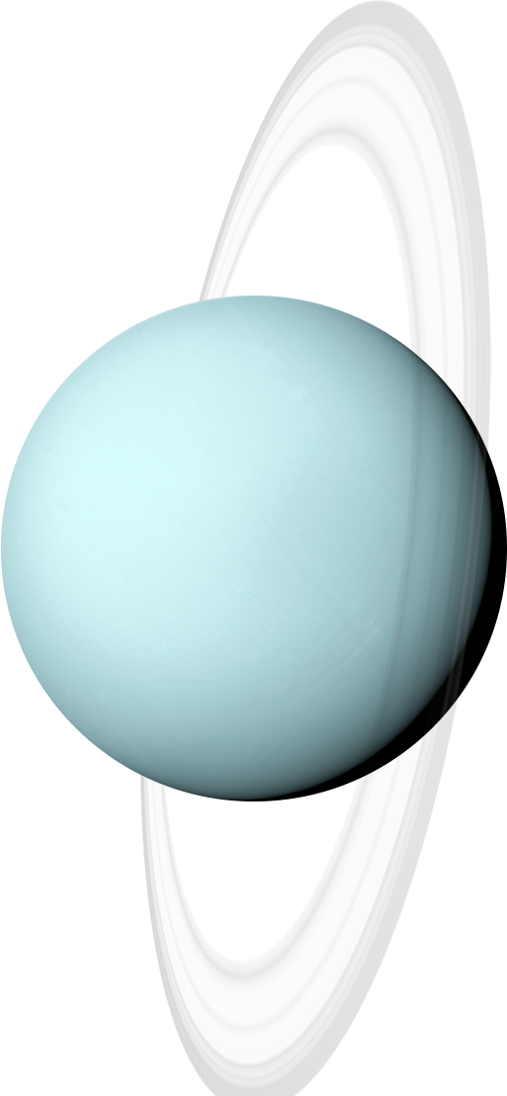
URANUS
Uranus is the first planet that was discovered thanks to the telescope.
It’s an «ice giant»: it has got a rocky center, and a thick atmosphere made of hydrogen, helium and methane. Methane makes Uranus blue.
Uranus is like Venus: it rotates in the opposite direction as most planets. In addition, it rotates on its side. It has got 13 rings.
A day on Uranus lasts 17 hours.
A year on Uranus lasts 30681 Earth days (84 years).
https://spaceplace.nasa.gov/all-about-uranus/en/

Slide 18
URANUS’ IDENTITY CARD
NAME | Uranus
POSITION | 7
TEMPERATURE | -195 (avg.)
MASS | 14,5 Earths
DIAMETER | 4 Earths
REVOLUTION TIME | 84 years
SATELLITES | 27
CURIOSITIES | Uranus is mostly made of flowing icy materials above a solid core.

Slide 19
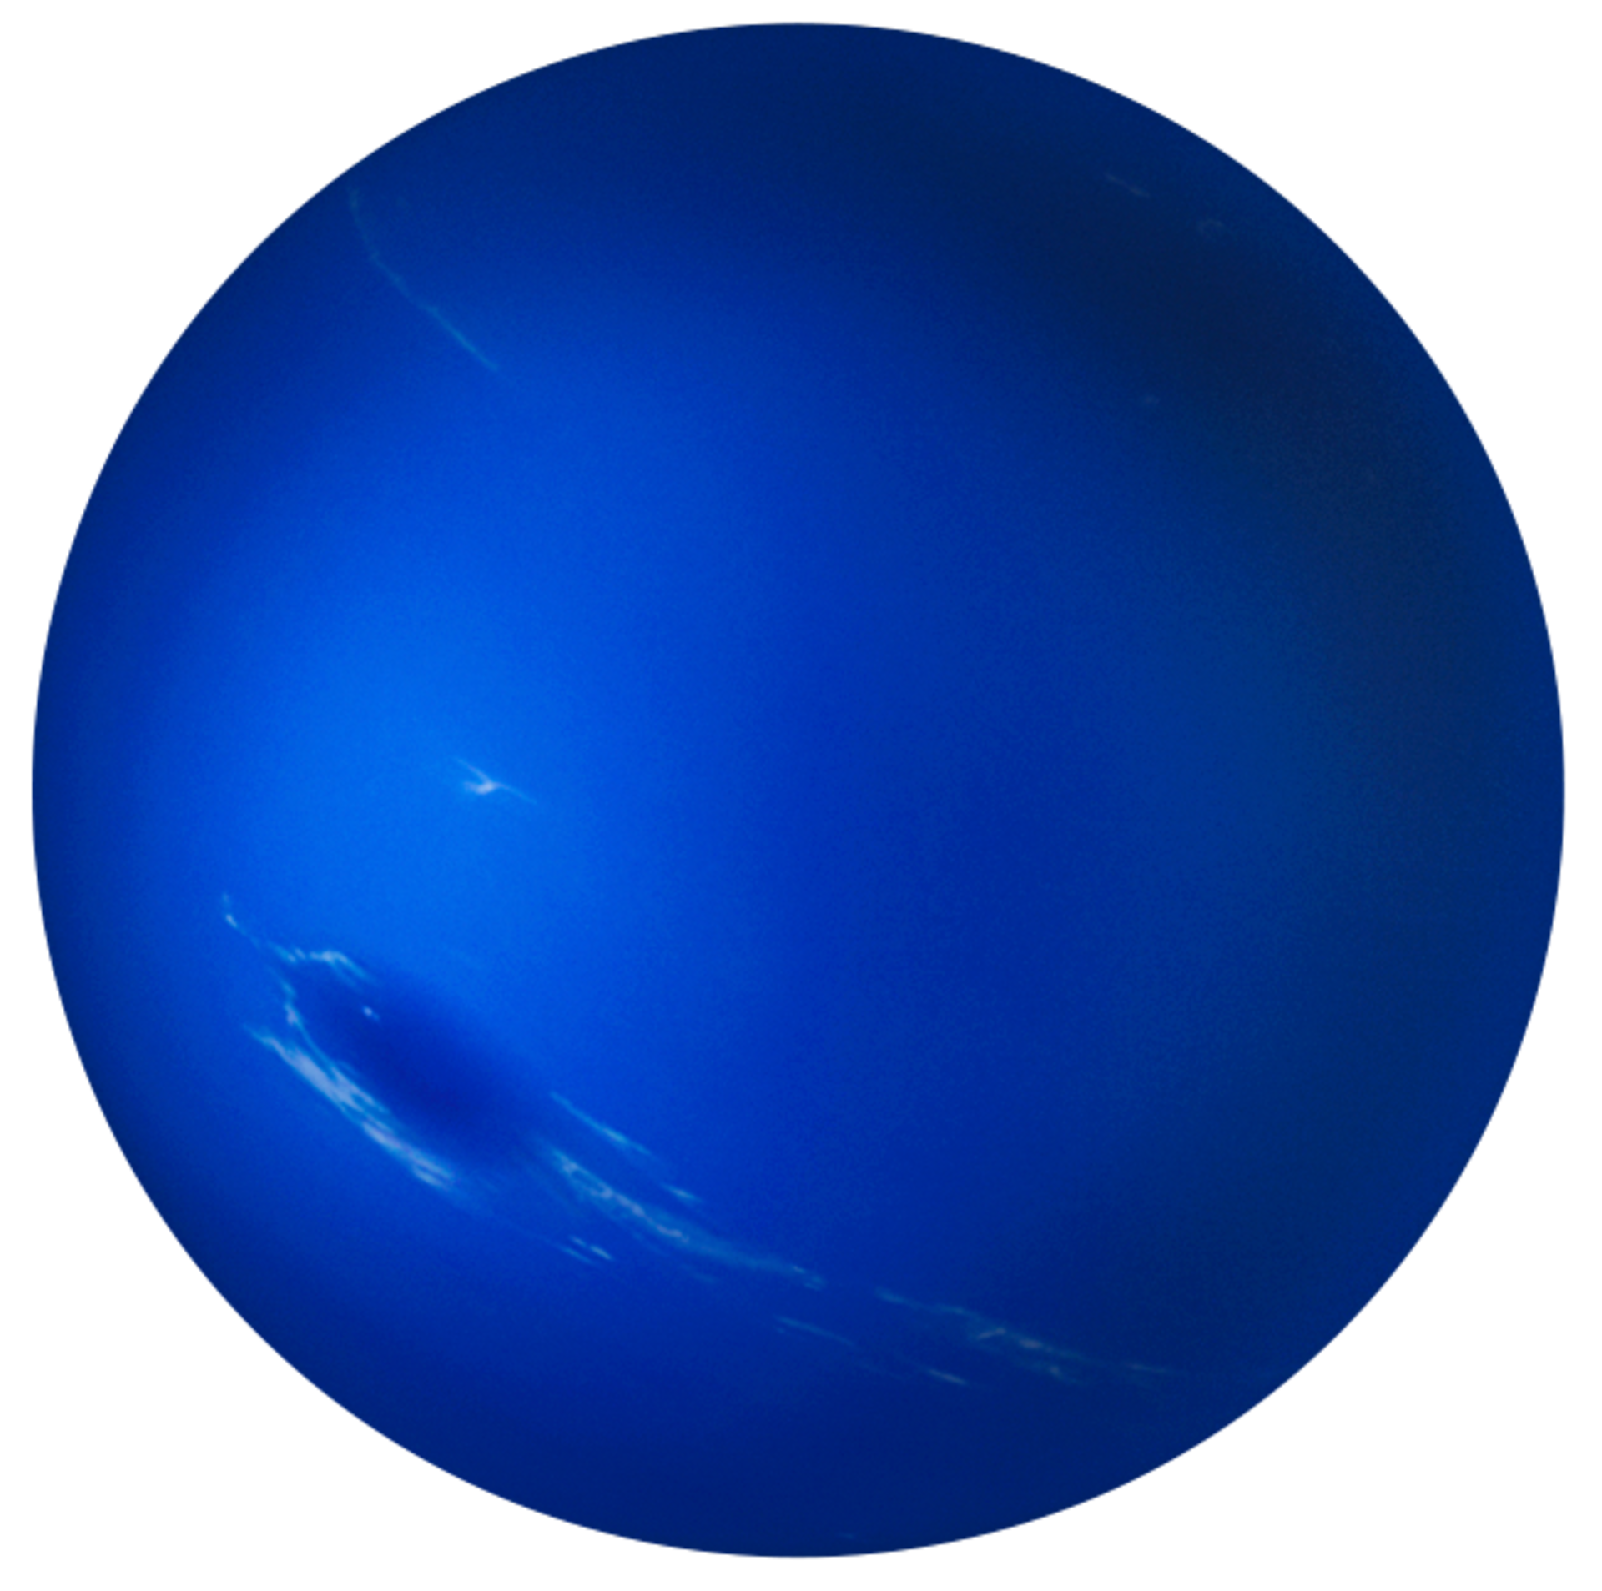
NEPTUNE
Neptune is the coldest and darkest planet of the solar system.
It’s an «ice giant»: it has got a rocky center, and a thick atmosphere made of hydrogen, helium and methane. It’s really similar to Uranus.
Neptune has got 6 rings. It has got a thick and windy atmosphere.
A day on Neptune lasts 16 hours.
A year on Neptune lasts 60266 Earth days (165 years).
https://spaceplace.nasa.gov/all-about-neptune/en/

Slide 20
NEPTUNE’S IDENTITY CARD
NAME | Uranus
POSITION | 8
TEMPERATURE | -200 (avg.)
MASS | 17,1 Earths
DIAMETER | 4 Earths
REVOLUTION TIME | 165 years
SATELLITES | 14
CURIOSITIES | Neptune is the last planet of the solar system. It is also the last one that has been discovered.

Slide 21
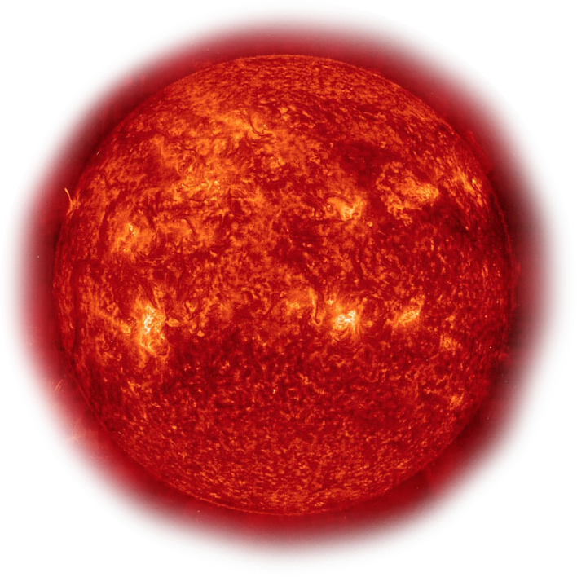
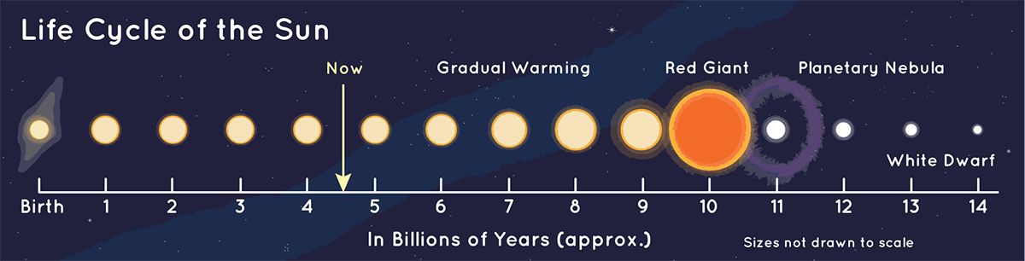
THE SUN
The sun is the biggest object of our solar system. It’s a star called «yellow dwarf».
The sun isn’t the biggest star in the universe. There are stars that are 100 times bigger than the sun. There are also stars that are 10 times smaller.
Its gravity holds the solar system together. It’s mostly made of hydrogen and helium. It’s 4.5 billion years old.
https://spaceplace.nasa.gov/all-about-the-sun/en/

Slide 22
SUN’S IDENTITY CARD
NAME | Sun
POSITION | 0
TEMPERATURE | 5500 (surface); 15 millions (core)
MASS | 330000 Earths
DIAMETER | 109 Earths
REVOLUTION TIME | /
SATELLITES | /
CURIOSITIES | We call it solar system, because solaris, in latin, means «of the sun».

Slide 23
Exercises
https://quizlet.com/_cld2zc?x=1qqt&i=1py29b
https://learningapps.org/watch?v=poz11v68k23
https://learningapps.org/watch?v=pqcy064ma23

